Slide 1
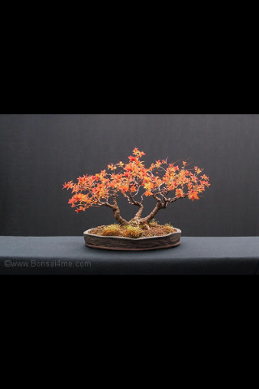
Bonsai

Slide 2
BONSAI is a Japanese word .
Its meaning - ‘growing a tree’
or
‘plant in a shallow pot or a tray'
It is the miniature form of plants

Slide 3
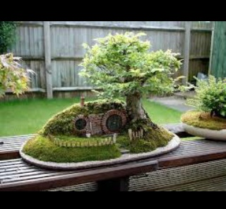
The Story
behind
bonsai

Slide 4
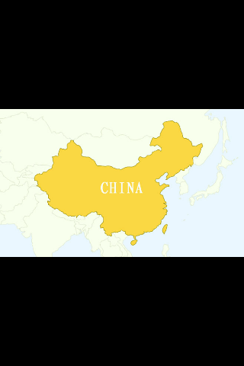
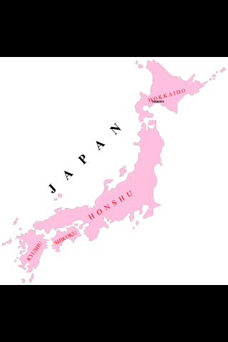
ORIGIN

Slide 5
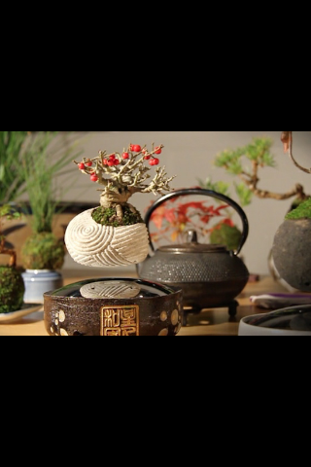
Selection of plants
For BONSAI

Slide 6
There are several plant species suitable for BONSAI
The most commonly used species include:
Ficus religiosa (pipal)
Polyalthia longifolia (asoka)
Delonix (poinciana)
Regia (gulmohur)
Cassia fistula (indian laburnum)
Feronia elephantum (wood apple)
Mangifera indica (mango)

Slide 7
Punica granatum (pomegranate)
Psidium guajava (guava)
Syzygium jambos (little jamun)
Acrus sapota (sapota)
Ixora coccinea (jungle flame)
Bougainvillaea glabra (paper flower)
Duranta
Bamboo
Etc………………………………………….

Slide 8
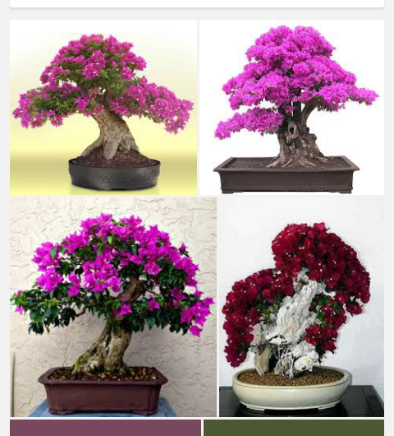
BONSAI of Bougainvillea

Slide 9
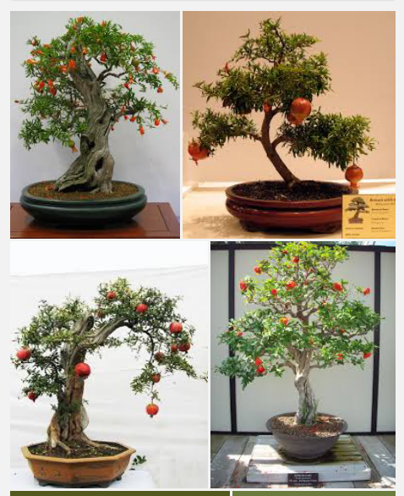
BONSAI of Pomegranate

Slide 10
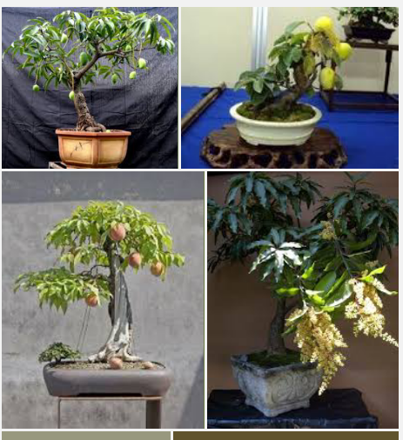
BONSAI of
Mango

Slide 11
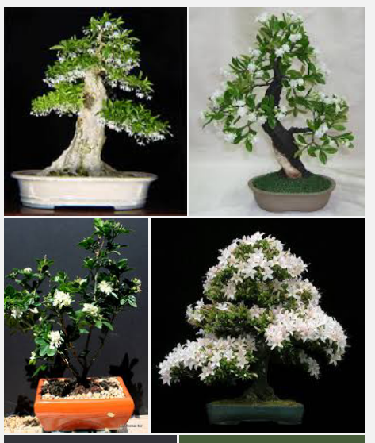
BONSAI of
Jasmine

Slide 12
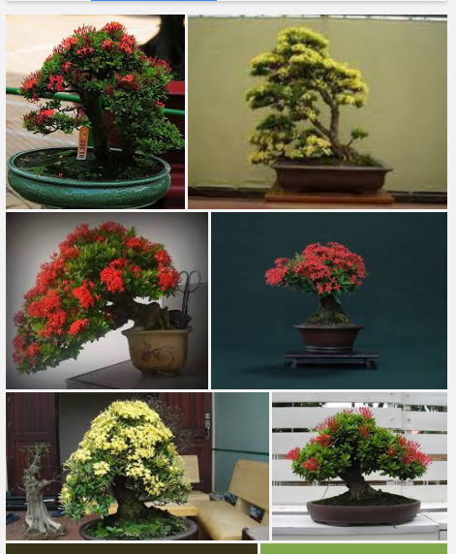
BONSAI of
Ixora

Slide 13
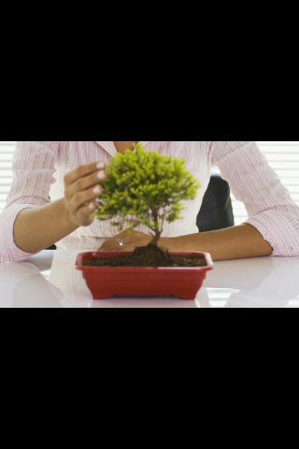
Time of planting BONSAI

Slide 14
The BONSAI plants are
Generally started in-
February-March
OR
July - Augest

Slide 15
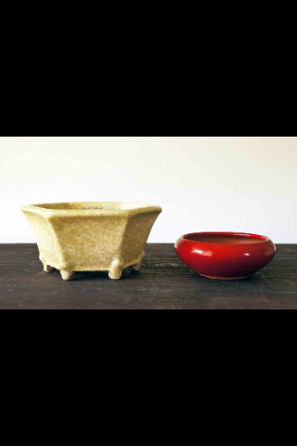
Stands and Containers
Used for BONSAI

Slide 16
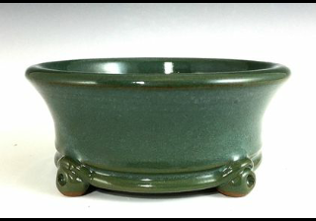
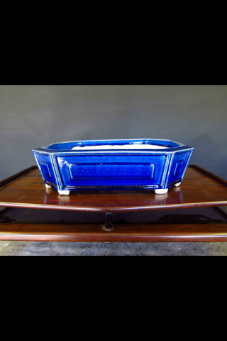
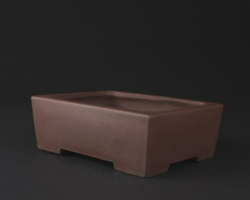
The normal size of the containers
Should be about
5-7 cm deep AND
45-60 cm in round/rectangle/
square

Slide 17
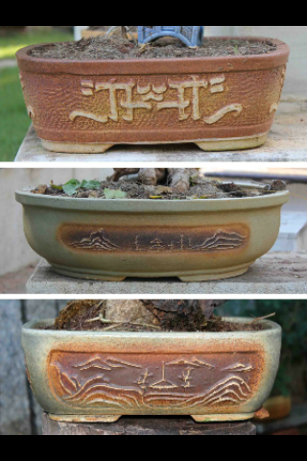
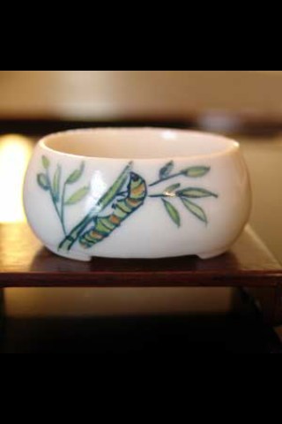

Slide 18
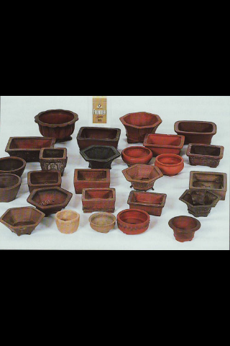
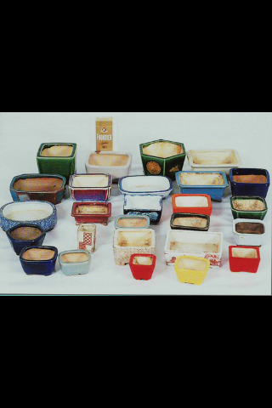

Slide 19
Pot Mixture
The pot mixture for bonsai consist of
-Red earth
-farmyard manure
-sand
-leafmould
all in equal proportion
The medium should be porus

Slide 20
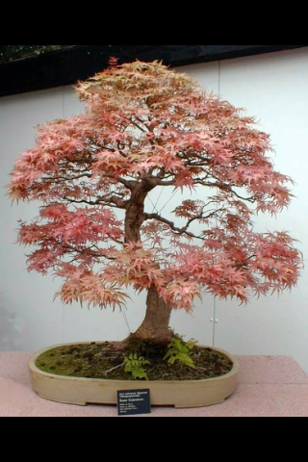
Planting details

Slide 21
The bonsai plants are grown from seeds ,
Cuttings, layering ,grafting
It takes longer time to propagate a bonsai from
seeds
The most convenient method is to start a bonsai
from a small plant obtained from a nursery
Another method is to bring a natural dwarf and
Stunted plant for making o bonsai

Slide 22
LIGHT AND TEMPERATURE:
Exposure to morning sunlight for 3-4 hours is ideal.
But avoid bright sunlight
Temperature is also essential.
At times , broken brick pieces or vermiculite kept
On the surface of the soil will maintain the moisture
And temperature for some extent

Slide 23
WIRING AND SHAPING
The crucial technique employed in shaping the plant
Is training them on metallic wires or with minimum
pruning
Regular trimming and training the plant to the desired
Shape is never ending process as it needs skill and
patience
At times ,when the trunk becomes bent or twisted
Copper wire should be coiled spirally around it from
the base up until it gets straightened

Slide 24
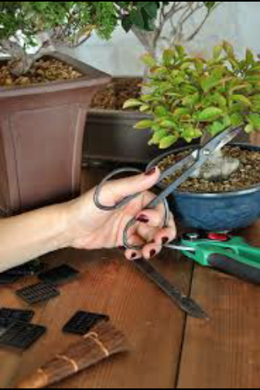
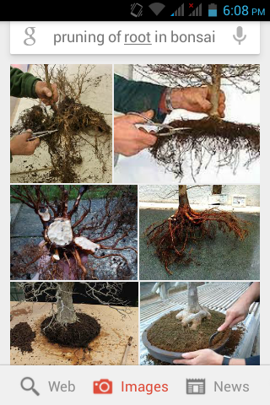
DWARFING TECHNIQUES
The plant is dwarfed by regular pruning of the
Root and Shoot

Slide 25
Root pruning is done in the cooler months
(december-january) once in a year or two
All the dead and decayed roots are removed from
the pots . This will encourage new growth of roots
Further shoot pruning should be done regularly
To keep the tree in proper size and shape .
Shoot pruning is done by trunk cutting, branch
Pruning , and even the removal of apical buds

Slide 26
Shoot pruning is done in winter. But the removal
of apical buds, pinching and tipping can be
done throughout the year
At times dwarfing is achieved through grafting
and the method of grafting will vary with the
species

Slide 27
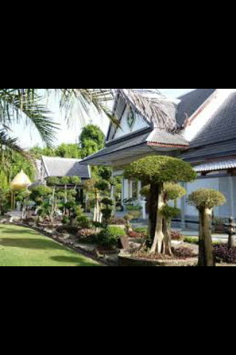
BONSAI Styles

Slide 28
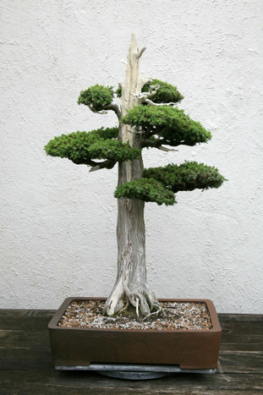
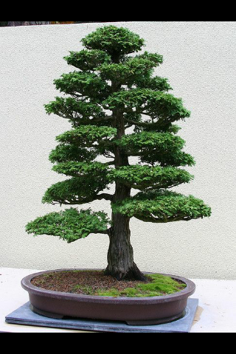
Formal upright bonsai

Slide 29
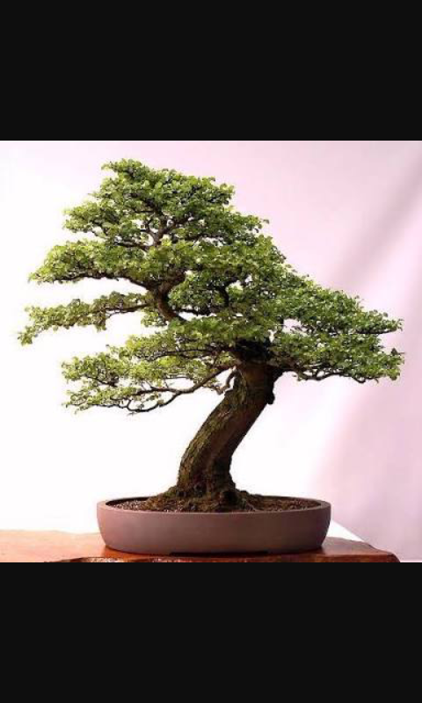
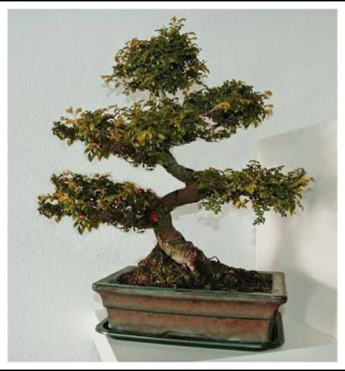
Informal upright bonsai

Slide 30
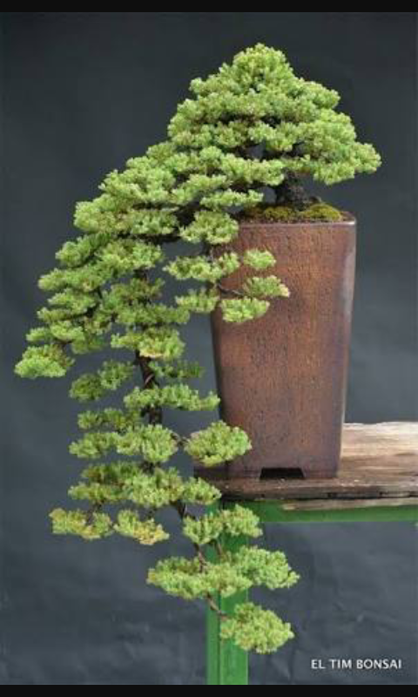
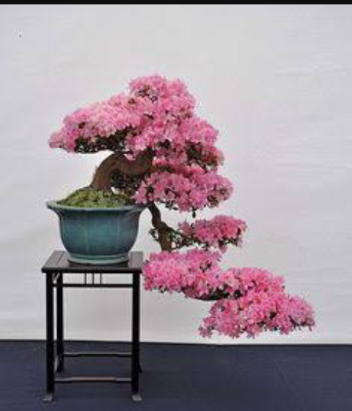
Cascade bonsai

Slide 31
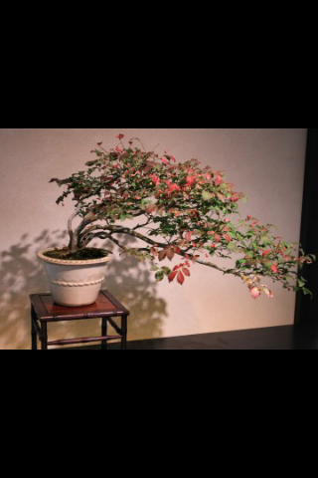
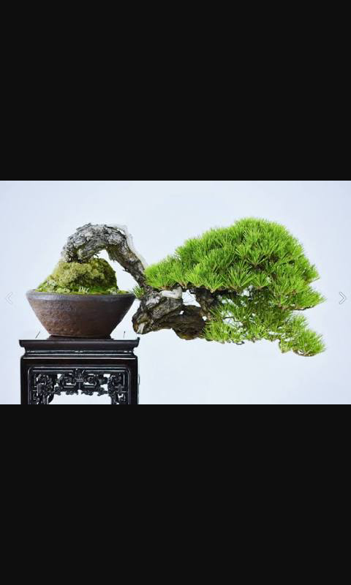
Semi cascade bonsai

Slide 32
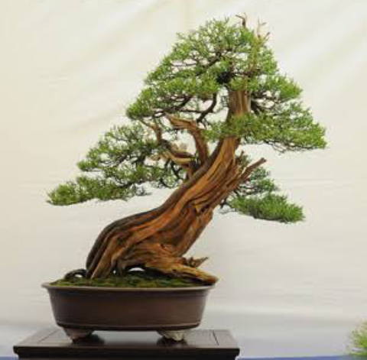
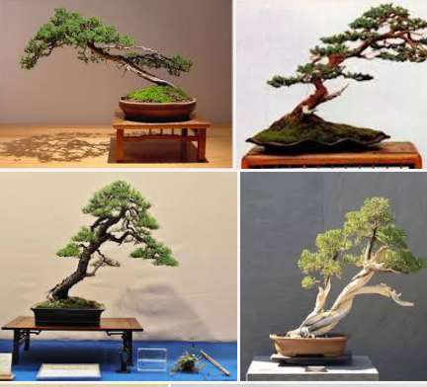
Slanting bonsai

Slide 33
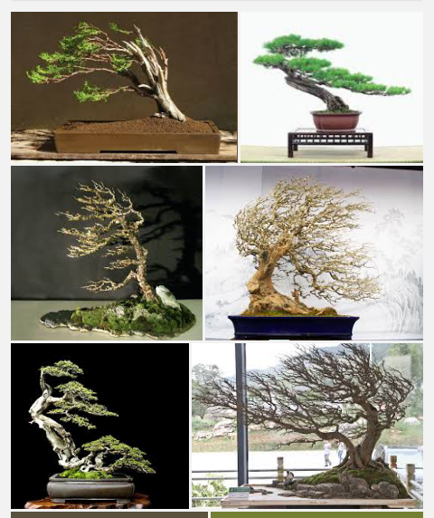
Windswept
bonsai

Slide 34
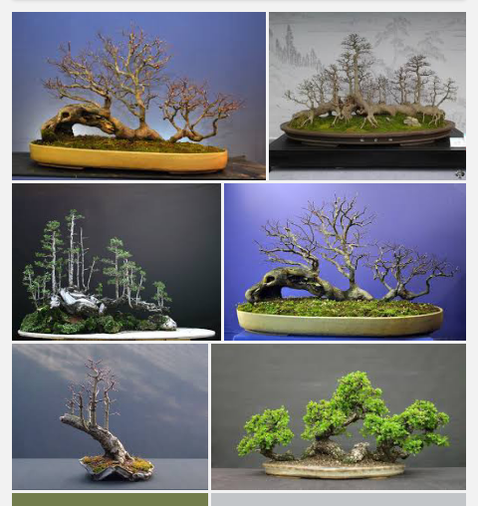
Raft bonsai

Slide 35
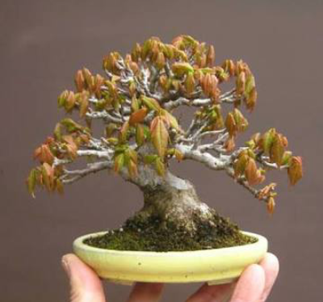
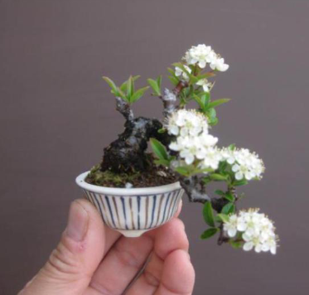
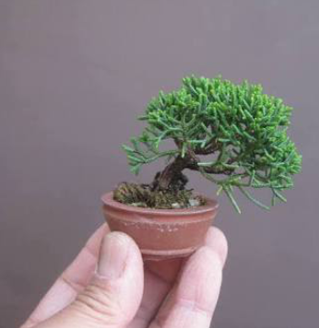
Mama bonsai

Slide 36
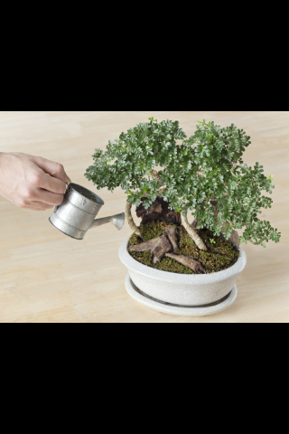
BONSAI
Watering

Slide 37
Watering depends upon
- The size of the pot
- The nature of the container
- pot mixture
Regular and judicious watering is required
Overwatering and waterlogging should be
avoided

Slide 38
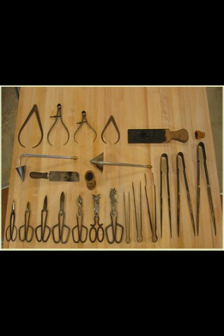
Tools used in making
BONSAI

Slide 39
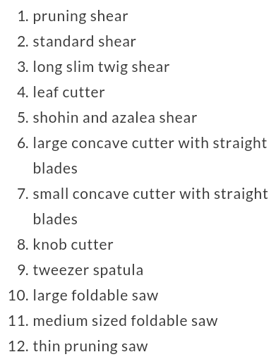
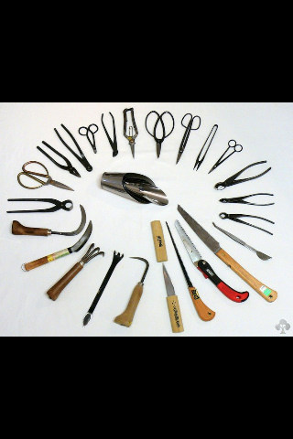
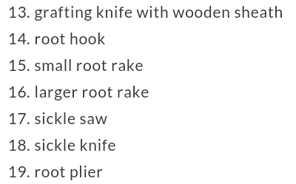

Slide 40
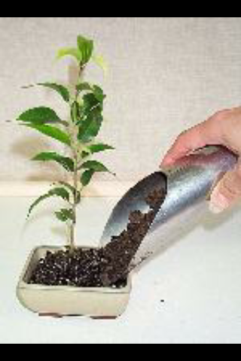
Manuring
Fertilizing
and

Slide 41
The objective of fertilizing is not to
make the bonsai grow, but to maintain
them in good health
Mixture of NPK or liquid manure
Prepared with oil cake (neem /mustard)
may be applied
Bone meal and superphosphate is good for
Flowering
Little potash is useful for fruiting

Slide 42
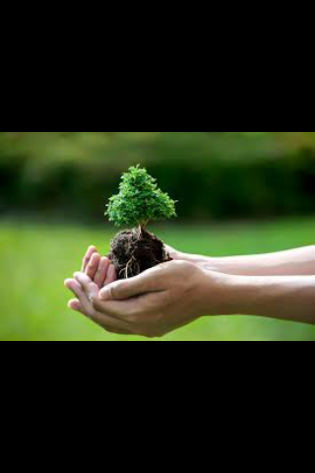
General Care

Slide 43
The soil in the pot should be hoed lightly
When it becomes hard
Frequent weeding, control of diseases,
And insect pest by pesticides, pinching ,
And pruning
Water regularly
Balanced nutrition
Provide adequate sunlight

Slide 44
Proper potting and repotting at proper
time

Slide 45
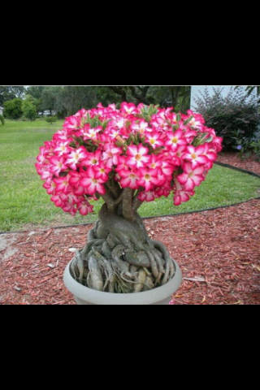
BONSAI and
Its Importance

Slide 46
Undoubtedly bonsai is ideal for small modern flats
as it require a minimum space
It is a good hobby
The materials used are cheap and do not require
any elaborate facilities
The price may vary according to the variety ,age ,health
and beauty of the plant
They are considered a source of fantasy and
imagination

Slide 47
They are the living piece of history
The Delhi administration is the first in India to provide
annual bonsai award for the best exhibit during the
flower show held by it
‘small is beautiful’ these days and if one cannot
bring the vast outdoors into the house ,
A touch of green can be added in a room or
a balcony by keeping a bonsai

Slide 48
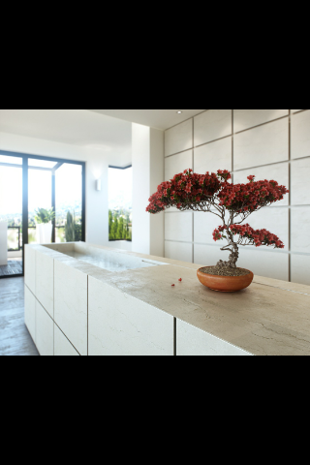
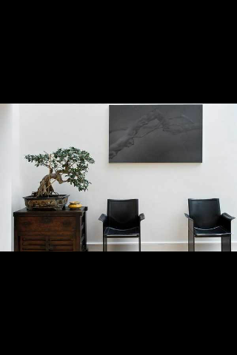

Slide 49
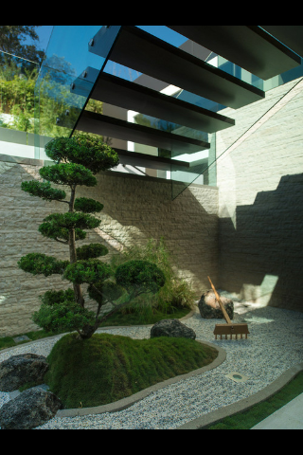

Slide 50
REFERENCE
Vishnu swarup , 1997 ,Ornamental Horticulture,
Rajiv Beri for macmillan India limited ,
New Delhi , page no: 397-400
K.Manibhushan Rao , 1991 , Text book of horti –
Culture , Rajiv Beri for macmillan India limited ,
Delhi , page no: 192-195

Slide 51
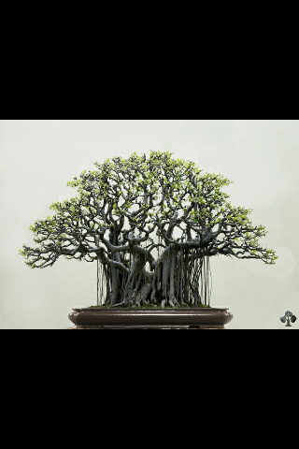
Thank you
……..
….

