Slide 1
Totipotency
It is the genetic potential of a plant cell to produce the entire plants.
The basis of TC is to stimulate totipotency and to grow large number of cells in a sterile controlled condition.

Slide 2
Totipotency
Callus
Differentiation
Embryogenesis ) Organogenesis Histogenesis
(Liquid media+24D) (Auxine + Cytokinine) (Coconut milk)
Embryoids Caulogenesis Rhizogenesis Xylem & phloem
Whole plant (Cytokine) (Auxine)
Shoot Caulorhizogenesis Root
Root & Shoot

Slide 3
Important of totipotency
1.Main objective in TC is Reconstruction of plant from totipetent cells
2.Help vegetative propagation of many economic important & Horticultural platns
3. Genetic modification of plants
4. Production of homozygous diploid plants
5. Somatic hybridization
6. Protoplast fusions of plants
7. Germplasm Preservation etc.

Slide 4
Re-differentiation
De- differentiation

Slide 5
Somaclonal Variations
The plants derived from TC has been referred to as somaclones,calli clones or protoclones etc
variations displaied by such plants are called somaclonal Variations.
According to Larkin and Scowcraft (1986); somaclonal variation is a genetic variability which is regenerate during TC.

Slide 6
Somaclonal Variations
Mechanism causing somaclonal variation
Chromosomal Aberation
Jumping gene production
DNA replication/ Mutation
Applications
Create variation in adapted genotypes without any treatment of mutagens
Get Agronomical & horticultural desired characters of several crops such as Rice, Wheat, Potato, and Tomato etc.

Slide 7
Plant tissue culture
Plant tissue culture is a collection of techniques used to maintain or grow plant cells, tissues or organs under sterile conditions on artificial nutrient culture medium invitro .
Father of plant Tissue culture - Haberlandt
Miller and Skoog used Growth hormones in TC
Plant tissue culture is widely used to produce clones of a plant in a method known as micropropagation.

Slide 8
Basic requirements for TC lab
Area for medium Preparation
A sterile room
Glassware and other instruments
Constant Temperature room
A shaker system
Nursery
Green house

Slide 9
MAINTENANCE OF ASEPTIC ENVIRONMENT
(a) Sterilization of Glassware- The glassware can be sterilized in a hot air oven at 160-1800C for 2-4 hours.
(b) Sterilization of instruments- The metallic instruments are incinerated by dipping them in 75% ethanol followed by flaming and cooling.
(c) Sterilization of nutrient media- The culture media are transferred into glass container, plugged with cotton or sealed with plastic closures and sterilized by autoclaving at 121 tem for 30 min.
(d) Sterilization of plant materials- The surface of the plant material is made sterile by using disinfectants e.g. sodium hypochlorite, hydrogen peroxide, mercuric chloride, or ethanol. The transfer of sterile plant material on to the nutrient medium is done under the cabinet of laminar airflow.
(e) Sterilization of Culture room and transfer area- the floor and walls of the culture room should be washed with detergent followed by 2% sodium hypochlorite or 95% ethanol. The sterilization can also be done by exposure to UV light. The cabinet of laminar air flow is sterilized by exposing to UV light for 30 min. and 95% ethanol 15 minutes before starting the work.

Slide 10
Methods of TC
Formulation of TC medium
Collection of Explants Materials
Surface sterilization of Explants
Inoculation of explant
Subculture
Regeneration of plants
Hardening
Transplant in the field

Slide 11
Nurient medium Ingredients
Macro-elements – N P K Ca Mg S
Micronutrients- Fe, Mn, Cu, Zn, B, Mb
Carbon source – Sucrose
Vitamins- Myo- iInositol
Amino acids- glycine
Hormones- Auxins and Cytokinine
PH - 5.8

Slide 12
MAJOR TYPES OF MEDIA
White’s medium - is one of the earliest plant tissue culture media
MS medium - formulated by Murashige and Skoog (MS) is most widely used for many types of culture systems
B5 medium - developed by Gamborg for cell suspension and callus cultures and at present it’s modified form used for protoplast culture
Nitsch’s medium developed by Nitsch and Nitsch and used for anther culture

Slide 13
Murashige and Skoog medium
Ingredients
Major salts (macronutrients)
Ammonium nitrate (NH₄NO₃) 1,650 mg/l
Calcium chloride (CaCl₂ · 2H₂O) 440 mg/l
Magnesium sulphate (MgSO₄ · 7H₂O) 370 mg/l
Potassium phosphate (KH₂PO₄) 170 mg/l
Potassium nitrate (KNO₃) 1,900 mg/l
Minor salts (micronutrients)
Boric acid (H₃BO₃) 6.2 mg/l
Cobalt chloride (CoCl₂ · 6H₂O) 0.025 mg/l
Cupric sulphate (CuSO₄ · 5H₂O) 0.025 mg/l
Ferrous sulphate (FeSO₄ · 7H₂O) 27.8 mg/l
Manganese sulphate (MnSO₄ · 4H₂O) 22.3 mg/l
Potassium iodide (KI) 0.83 mg/l
Sodium molybdate (Na₂MoO₄ · 2H₂O) 0.25 mg/l
Zinc sulphate (ZnSO₄·7H₂O) 8.6 mg/l
Na₂EDTA · 2H₂O 37.2 mg/l
Vitamins
Myo- iInositol 100 mg/l
Niacin 0.5 mg/l
Pyridoxine · HCl 0.5 mg/l
Thiamine · HCl 0.1 mg/l
Amino acids:-
Glycine. 2mg/l
Hormones
IAA 1–30 mg/l
Kinetin 0.04–10 mg/l
Glycine (recrystallized) 2.0 mg/l
Carbon Source : Sucrose 20g/l
Agar 6.5 g/l
An optimum pH of 5.8 should be maintained.

Slide 14
Explant sterilization
washing explants (lateral buds) with detergent than 30 min
water than 70 % ethanol for 1 min.
Later using % 0.5 Na Hypochloride for 25 minutes
wash 3 times sterile distilled waterusing different antibitics (alphacillin, gentamycin...)
% 0.5 Na Hypochloride wash with sterile water than
mercuric chloride.01% 1 min
wash 3 times sterile distilled
Inoculation
Sub culture in another fresh medium

Slide 15
Regeneration of plats from TC
Callus:- Cells of explants dived repeatedly and grow in to mass of parenchymatous cells
Organogenesis :- Development of root and shoot directly from callus
Embryogenesis:- Production of embryo like structure from callus

Slide 16
Formation of organ in callus depends on medium constitutes because medium of tissue culture also contain growth regulators witch determine to shoot regeneration or root regeneration.
for this auxin and cytokinin ratio used in a appropriate ratio witch responsible for callus regeneration.
more concentration of cytokinin compare auxin generated to shoot part in callus and more quantity of auxin generated to roots in callus.
plant growth regulators like auxin, cytokinin, gibberelin, ethylene, abscisic acid, etc are affect to callus regeneration according ratio of them in medium.
ORGANOGENESIS IN PLANTS

Slide 17
ANTHER CULTURE
Anther culture id a technique by which the developing anthers at a precise and critical stage are excised aseptically from unopened flower bud and are cultured on a nutrient medium where the microspores within the cultured anther develop into callus tissue or embryoids that give rise to haploid plantlets either though organogenesis or embryogenesis.

Slide 18
ANDROGENESIS
Androgenesis is the in vitro development of haploid plants originating from totipotent pollen grains through a series of cell division and differentiation.
It is of two types.

Slide 19
ANDROGENESIS
Direct androgeneis:-
The microspores behaves like a zygote and undergoes chance to form enbryoid which ultimately give rise to a plantlet.
Indirect Androgenesis:-
The microspores divide repeatedly to form a callus tissue which differentiates into haploid plantlets.

Slide 20
FACTOR INFLUENCING ANTHER CULTURE
CULTURE MEDIUM:-
The anther culture medium requirements vary with genotype and probably the age of the anther as well as condition under which donor plants are grown.
In corporation of activated charcol into the medium has stimulated the induction of androgenesis.
The iron in the medium plays a very important role for the induction of haploids .
Potato extracts ,coconut milk and growth regulators like auxin and cytokininare used for anther and pollen culture.

Slide 21
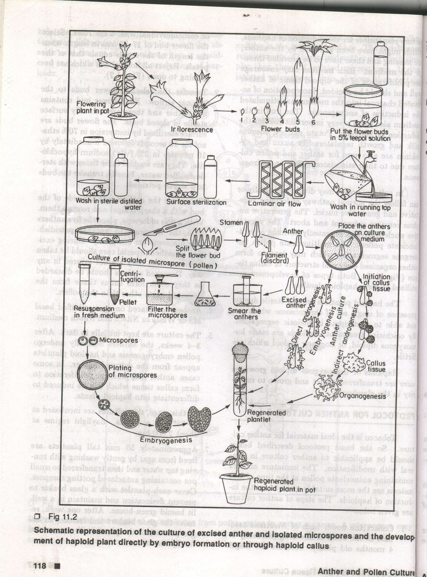
METHOD OF ANTER CULTURE

Slide 22
ADVANTAGE OF ANTHER CULTURE
During anther culture there is always the possibility that somatic cells of the anther that are diploid will also respond to the culture condition and so produce unwanted diploid calli or plantlets.
Sometimes the development of microspores inside the anther may be interrupted due to growth inhibiting substances leaking out of the anther wall in contact with nutrient medium.

Slide 23
IMPORTANCE OF ANTHER CULTURE
(a) cytogenetic studies.
(b)Study of genetic recombination in higher plants.
(c) Study of mode of differentiation from single cell to hole organism.
(e) Formation of double haploid that are homozygous and fertile.

Slide 24
IMPORTANCE OF POLLEN AND ANTHER CULTURE
(1)Utility of anther and pollen culture for basic research:-
(a) cytogenetic studies.
(b)Study of genetic recombination in higher plants.
(c) Study of mode of differentiation from single cell to hole organism.
(d) Study of factor controlling pollen embryogenesis of higher plants.
(e) Formation of double haploid that are homozygous and fertile.

Slide 25
Anther culture are use for mutation study. Example :- Nitrate reductae mutants are reported in Nicotiana tabacum.
Anther culture use for plant breeding and crop improvement.
Anther culture are use to obtain the alkaloid Example :- Homozygous recombination Hyoscyamus niger having higher alkaloid content is obtain by anther culture.
Haploid are use in molecular biology and genetic engineering.

Slide 26
Plant tissue culture applications
The production of exact copies of plants that produce particularly good flowers, fruits, or have other desirable traits.
The regeneration of whole plants from plant cells that have been genetically modified.
The production of plants in sterile containers that allows them to be moved with greatly reduced chances of transmitting diseases, pests, and pathogens.
To clean particular plants of viral and other infections and to quickly multiply these plants as 'cleaned stock' for

Slide 27
The commercial production of plants used as potting, landscape, and florist subjects, which uses meristem and shoot culture to produce large numbers of identical individuals.
To conserve rare or endangered plant species.
A plant breeder may use tissue culture to screen cells rather than plants for advantageous characters, e.g. herbicideresistance/tolerance.
Large-scale growth of plant cells in liquid culture in bioreactors for production of valuable compounds, like plant-derived secondary metabolites and recombinant proteins used as biopharmaceuticals.
To cross distantly related species by protoplast fusion and regeneration of the novel hybrid.
For chromosome doubling and induction of polyploidy, for example doubled haploids, tetraploids, and other forms ofpolyploids. This is usually achieved by application of antimitotic agents such as colchicine or oryzalin.
.

