Slide 1
MUSHROOM SPAWN PREPARATION
Manjula.c ,NAS College Kanhangad

Slide 2
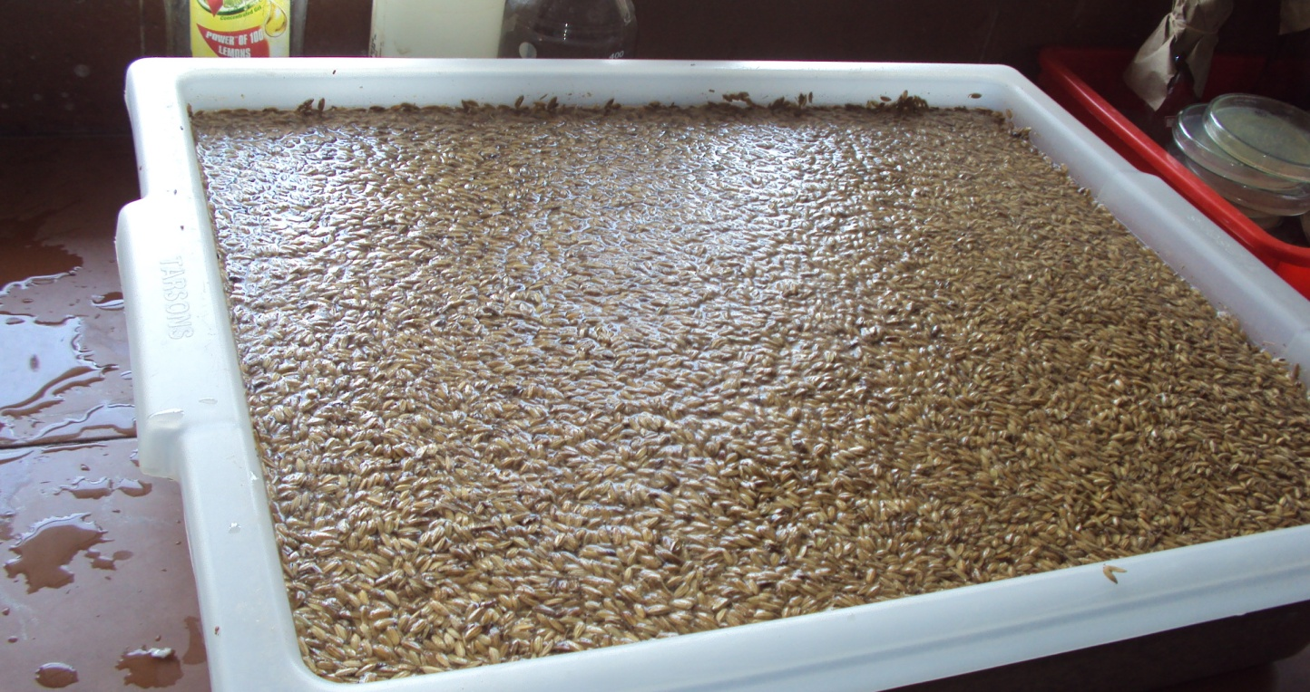
GRAIN SOAKED IN WATER 12HOURS

Slide 3
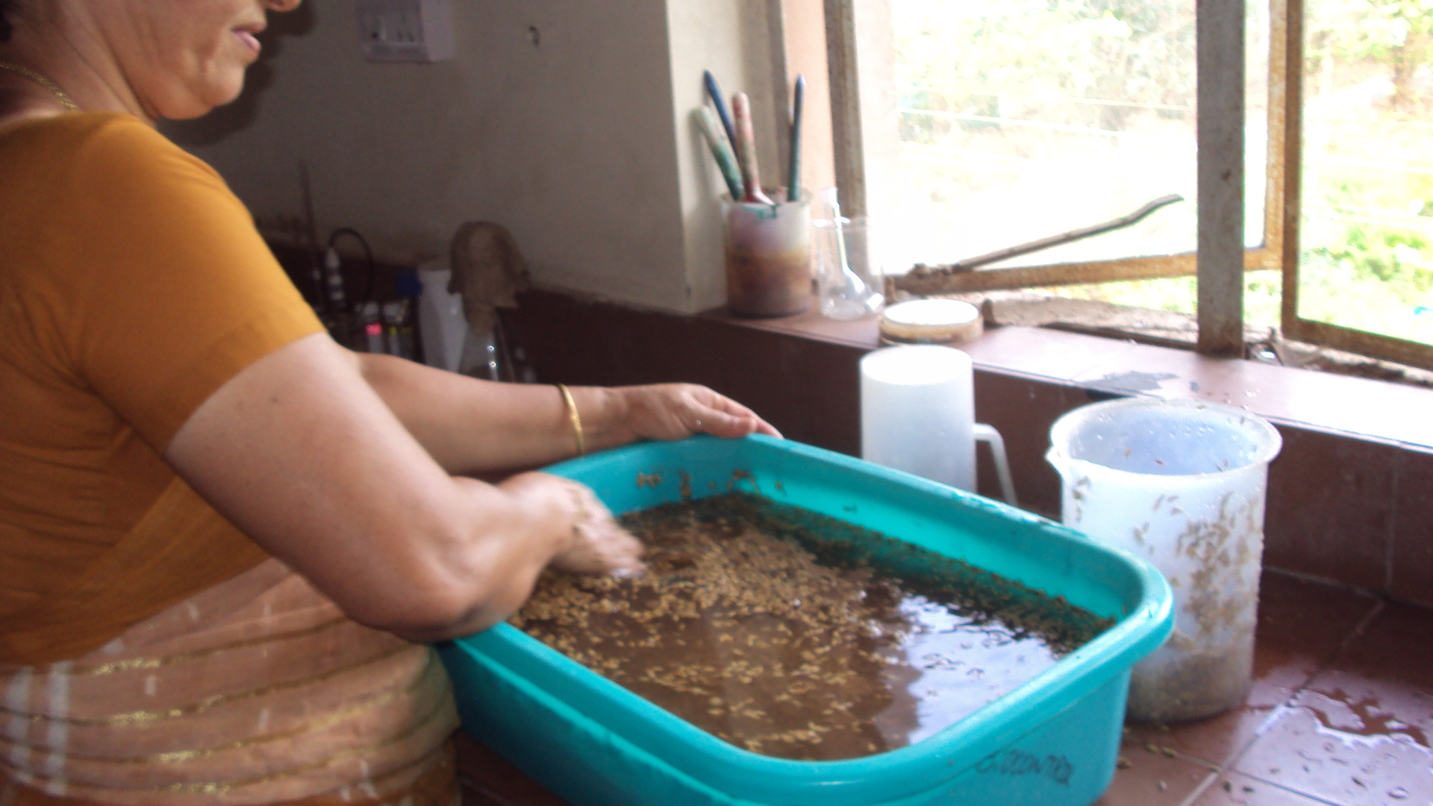
WASHING THE GRAIN

Slide 4
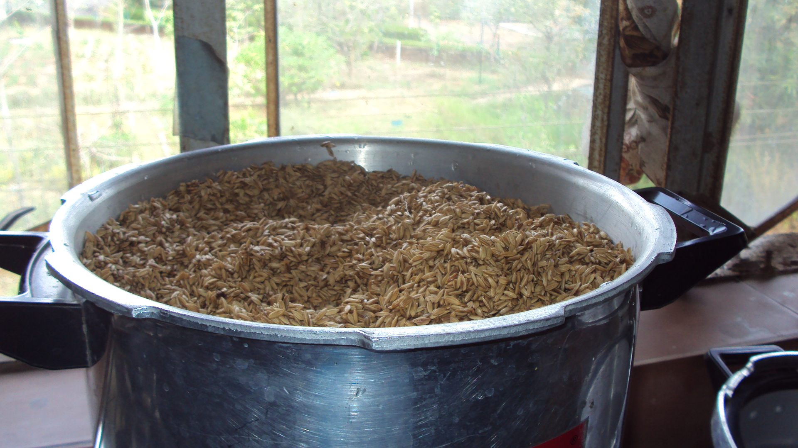
BOILING THE GRAIN

Slide 5
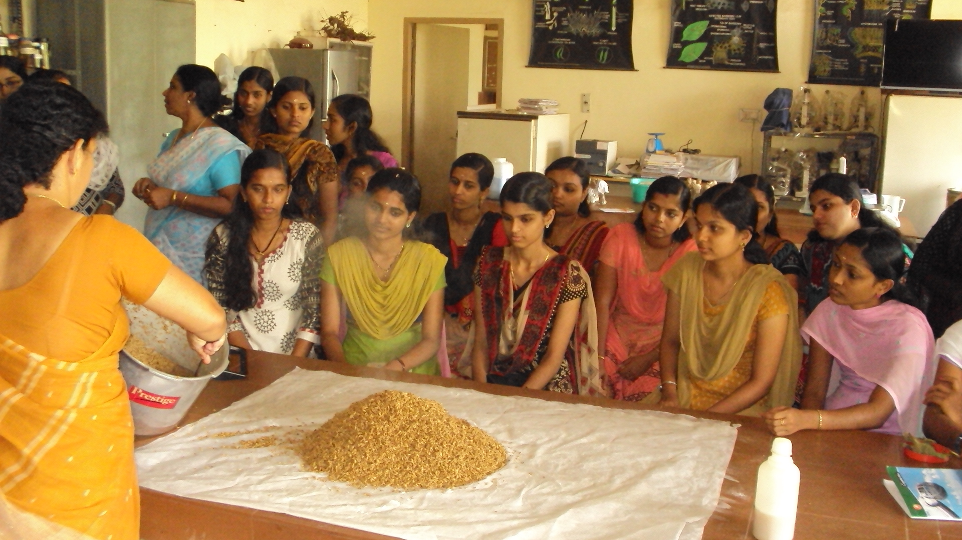
SPREAD IN STERILE CLOTH

Slide 6
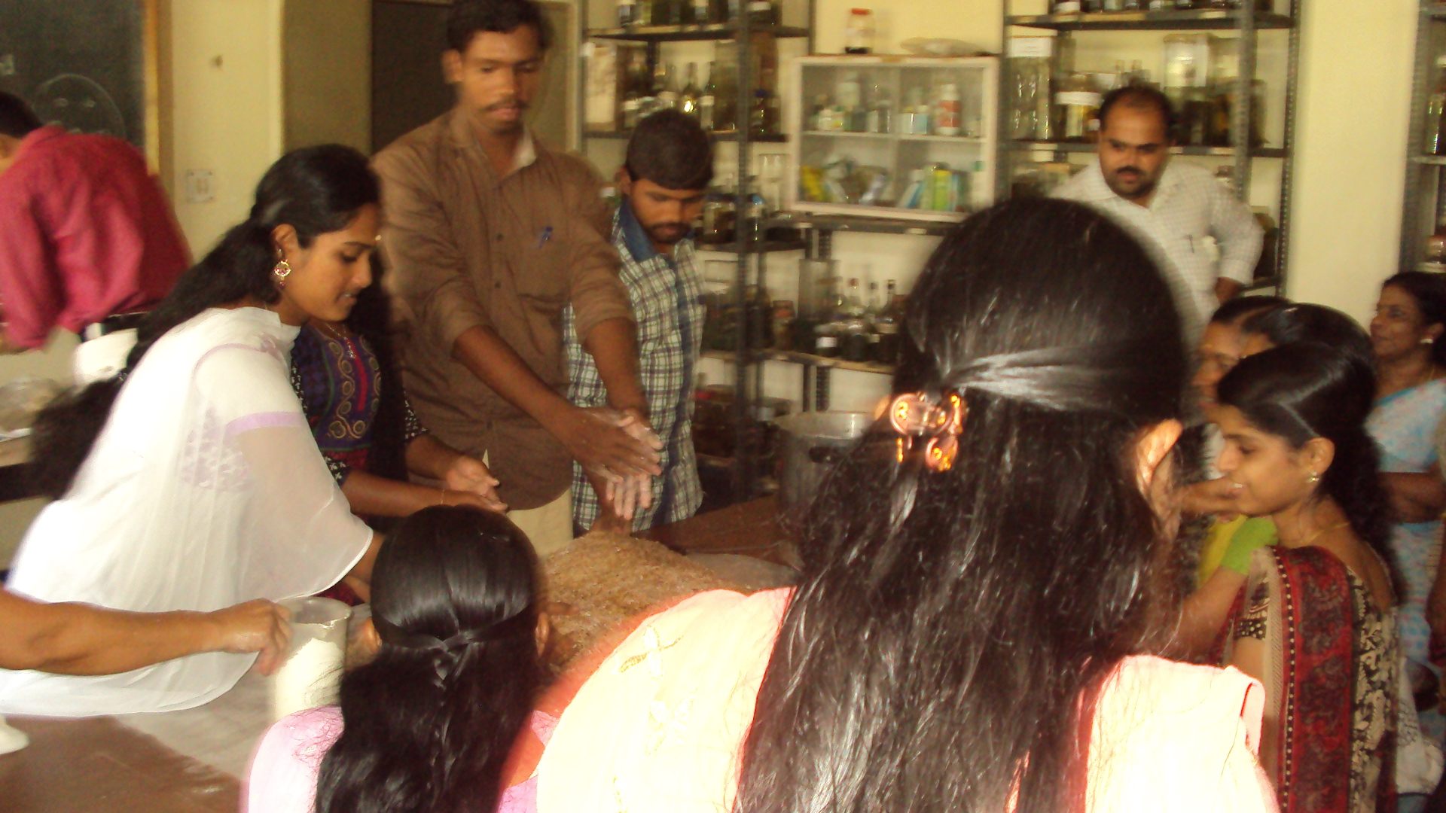
GRAIN MIXED WITH 2% CALCIUM CARBONATE

Slide 7
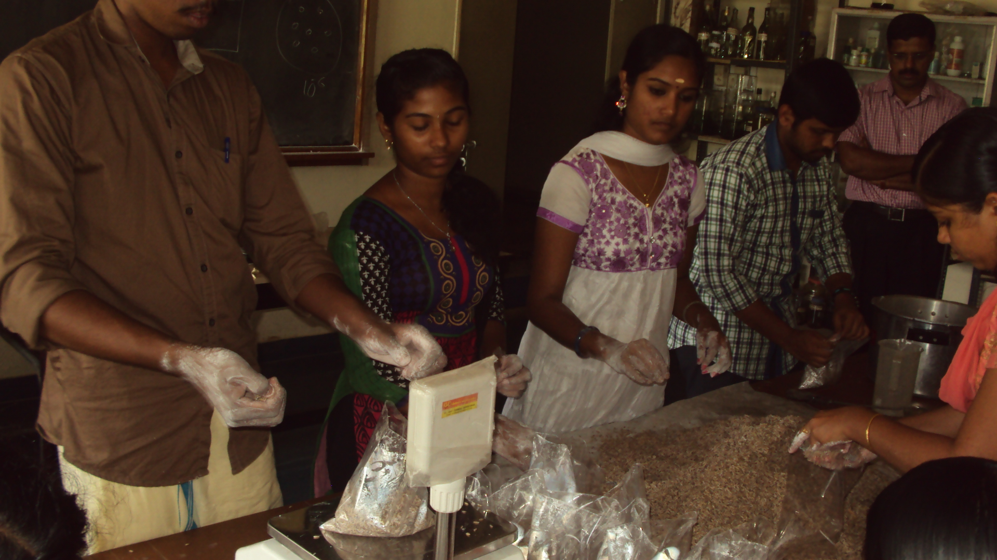
WEIHGING THE GRAIN

Slide 8
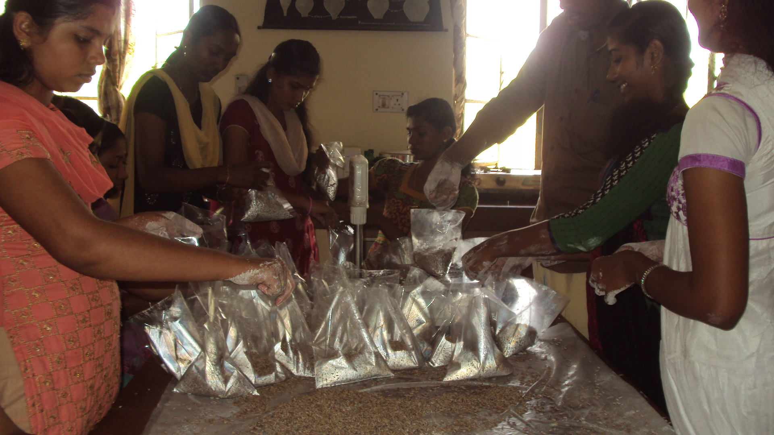
PLUGG THE POLY BAG

Slide 9
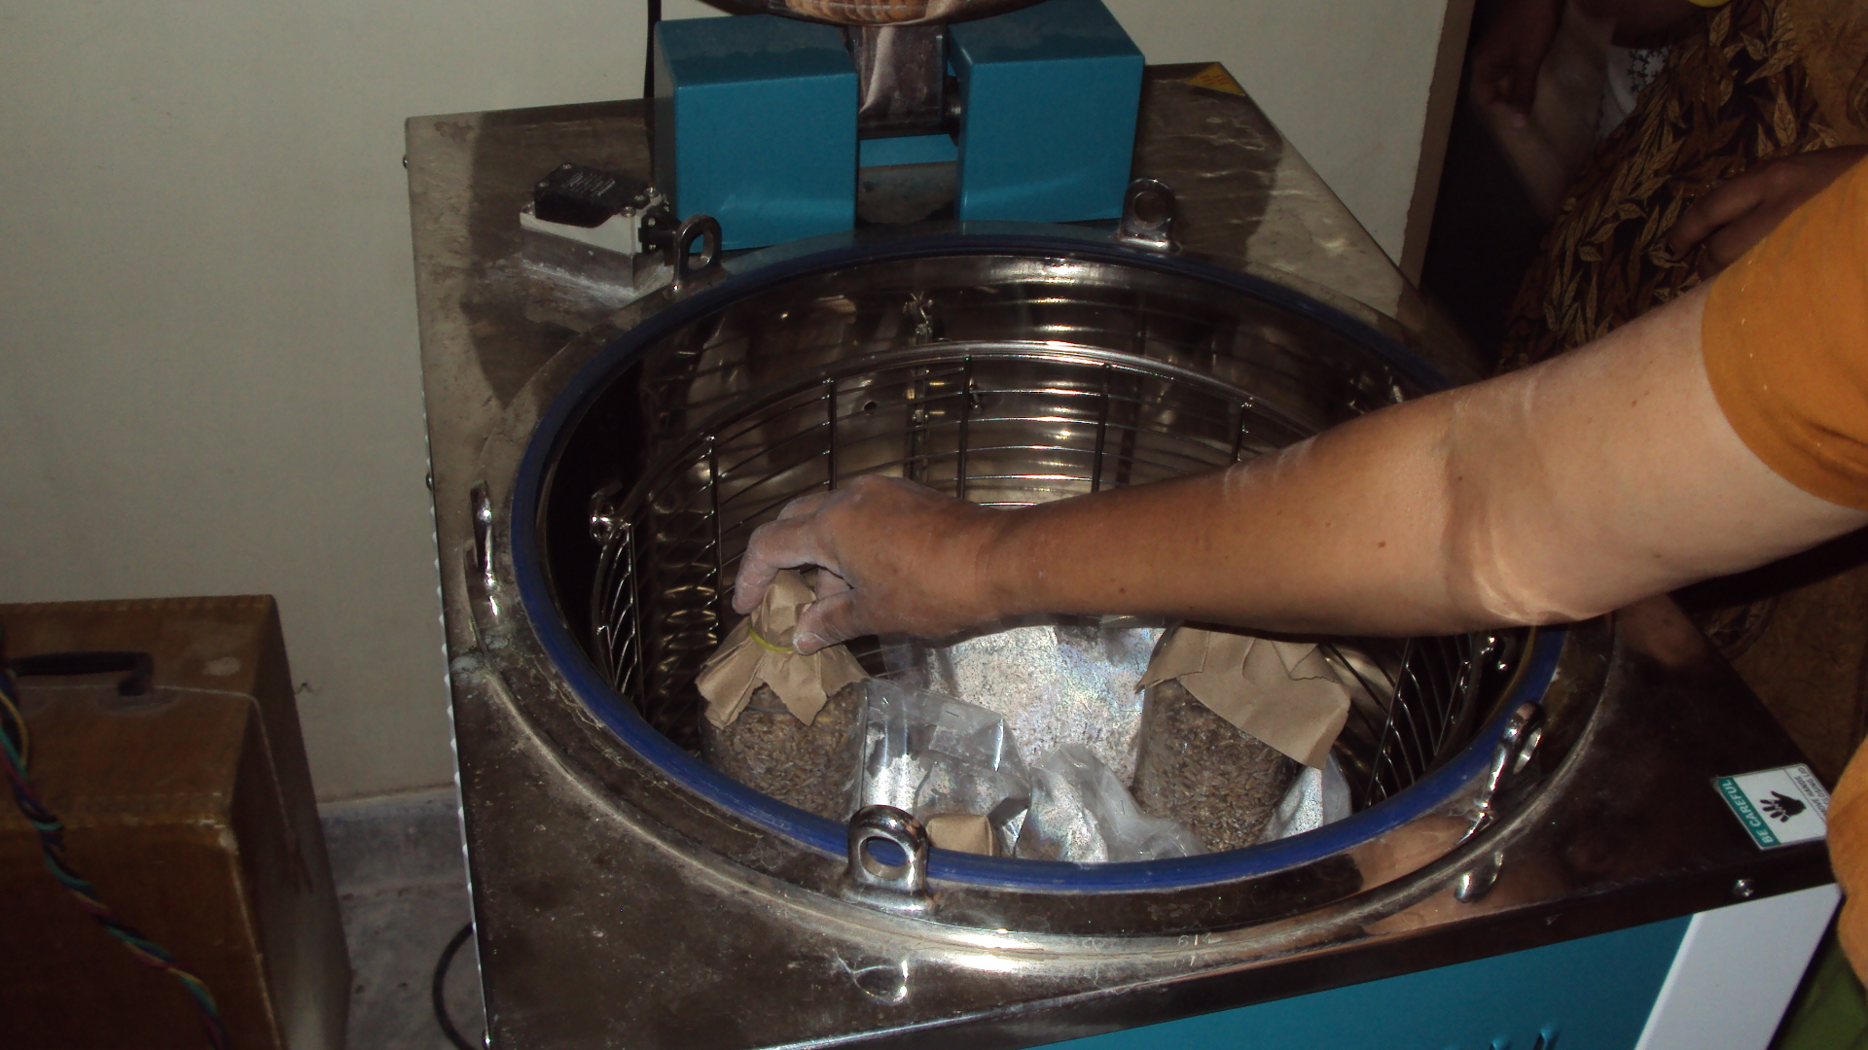
PUT THE GRAIN BAGS IN THE AUTOCLAVE

Slide 10
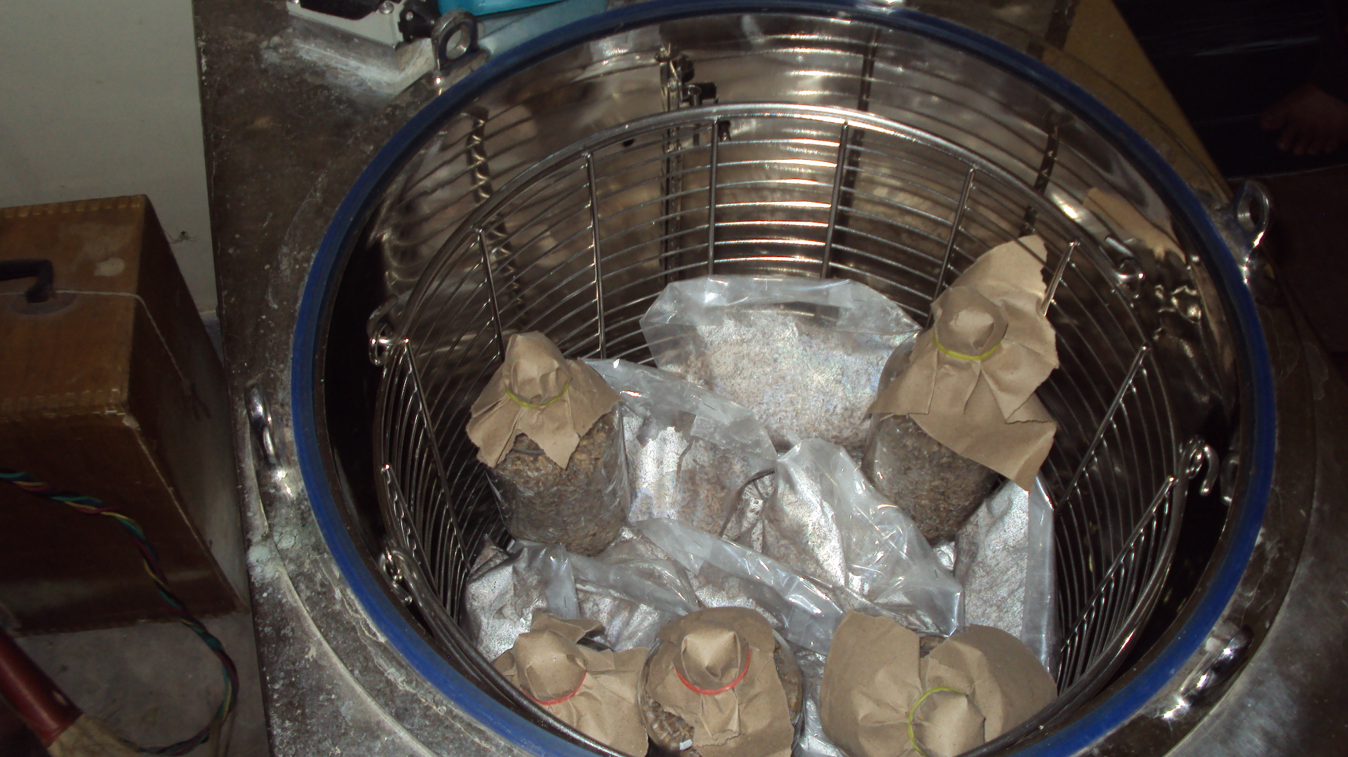
STEAM STERILIZATION OF GRAIN BAGS 20MINUTES

Slide 11
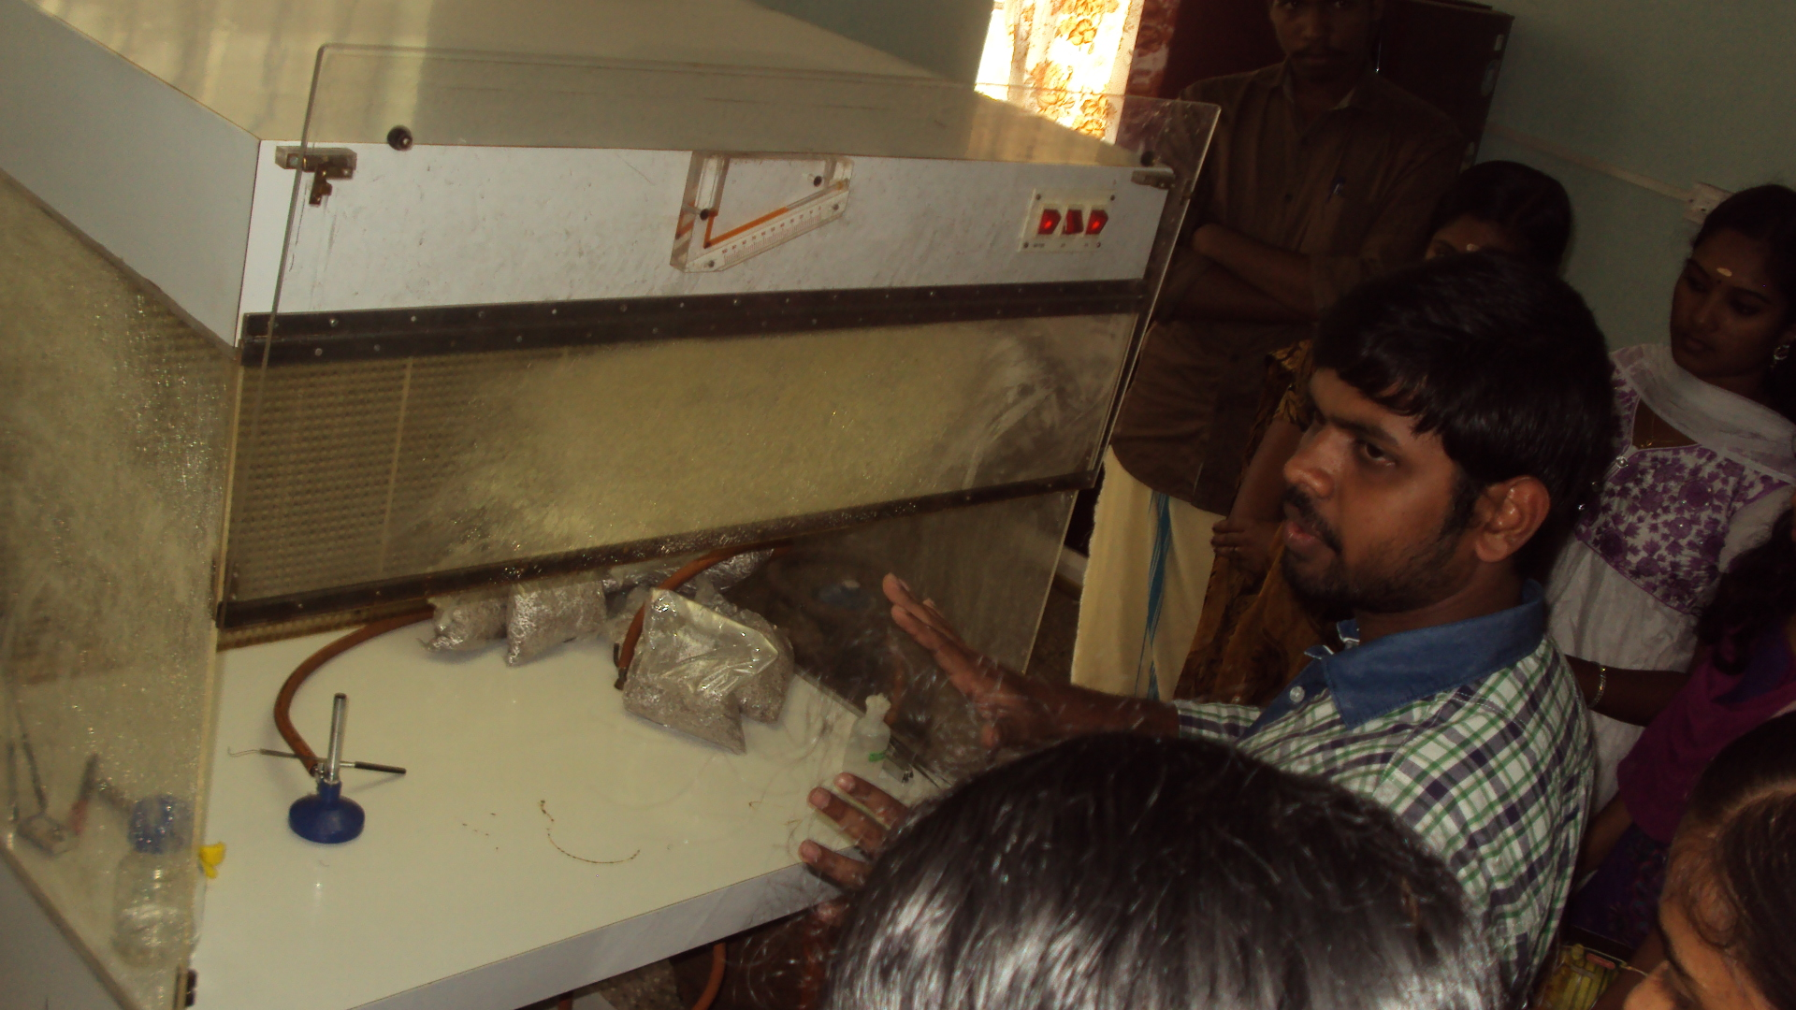
INOCULATION OF MUSHROOM MYCELIUM IN STERILIZED GRAIN

Slide 12
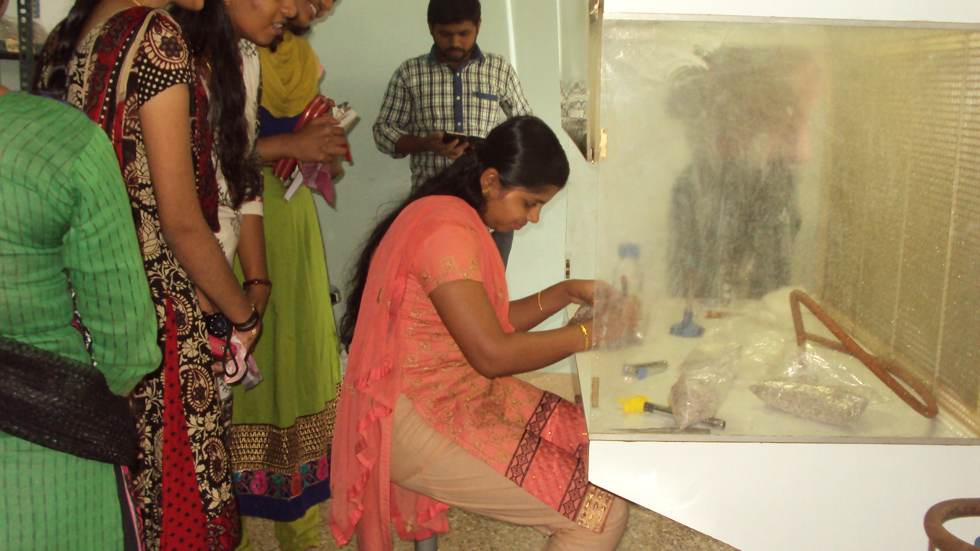
INOCULATION

Slide 13
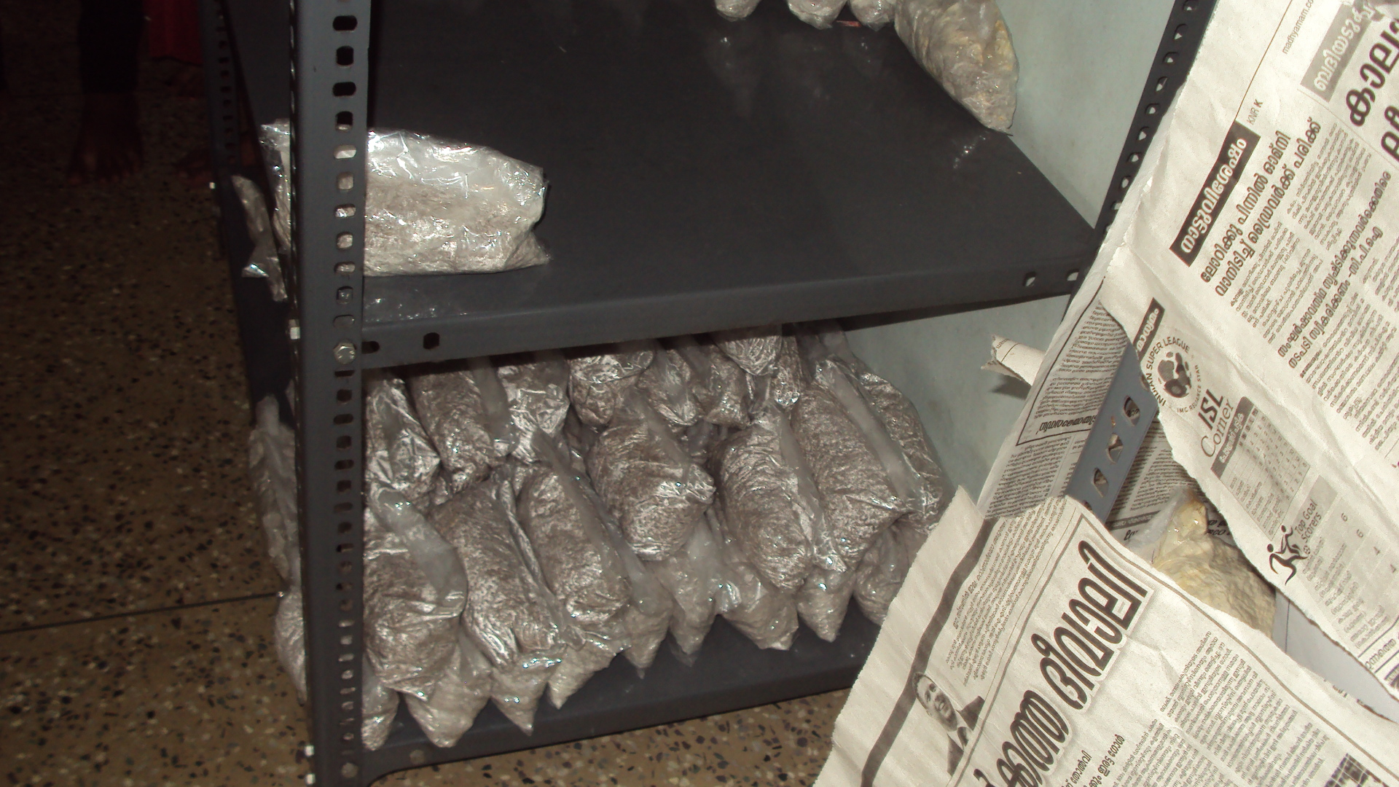
SPAWN RUNNING ROOM

Slide 14
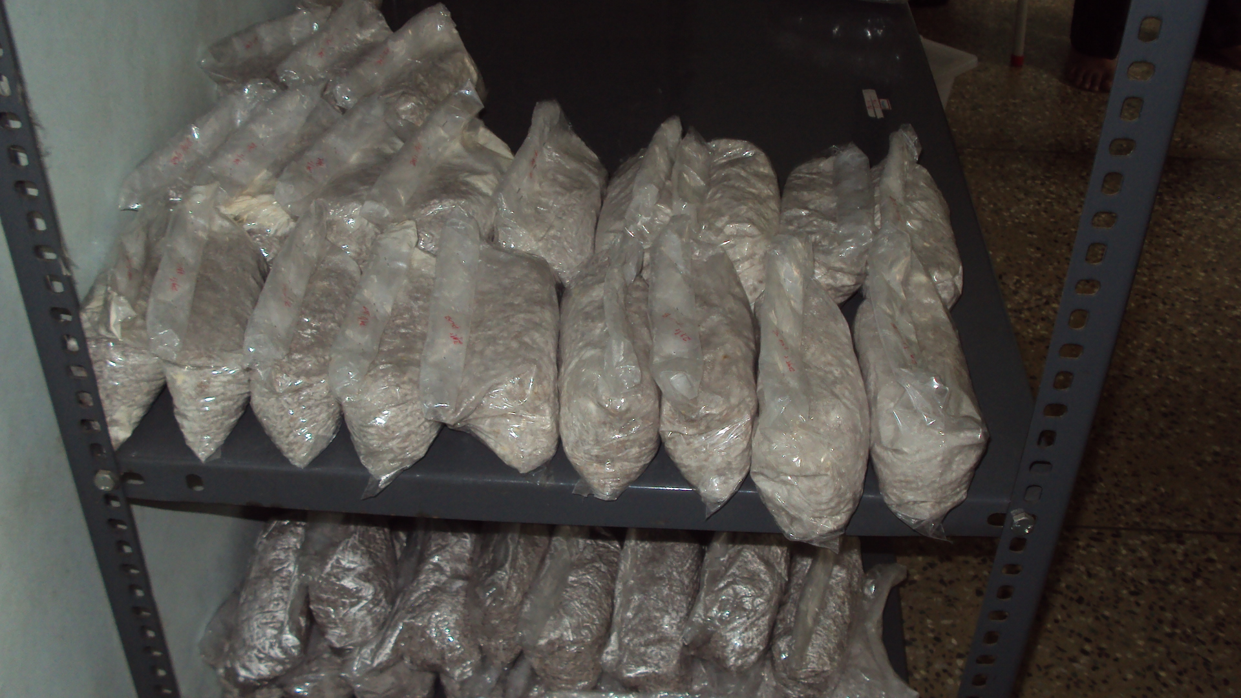
AFTER 15 DAYS

Slide 15
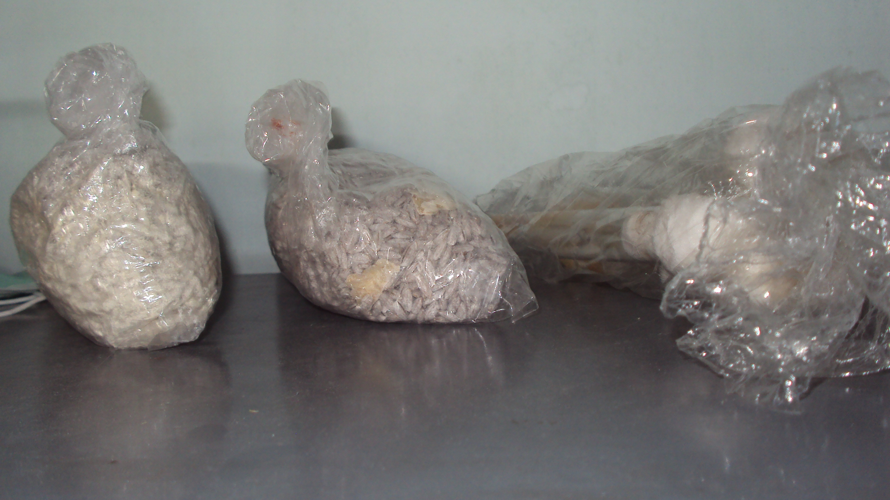
SPAWN READY FOR CULTIVATION

