Slide 1
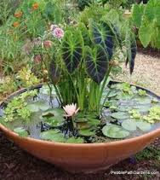
Water garden

Slide 2


